Slide 1
Instagram User Analytics
A Project on SQL Fundamentals
By- Alankar Saxena

Slide 2
Description- In the analysis of given Instagram Data,
we have done certain filtering operations such as
finding maximum likes on a post, data related to
users etc.
Approach- We have used SQL for filtering operations and written
SQL queries for given filtering operations. We have written queries to
filter out desired outputs from the given data. The Database was
already created and given, we did the filtering operations and found out the desired outputs.
Tech Stack- We have used MySQL for the project as it manages
and manipulates data efficiently.

Slide 3
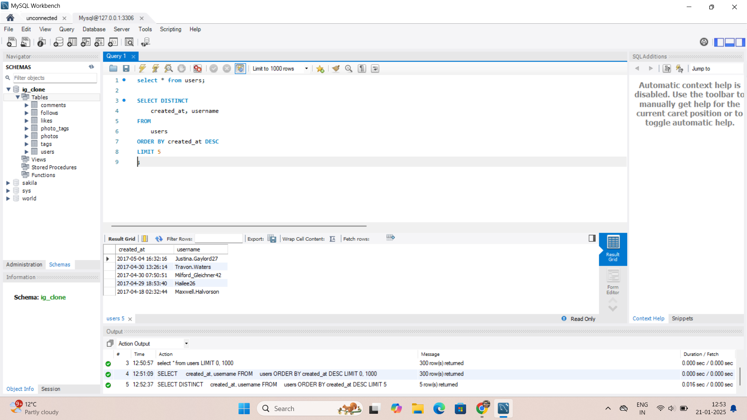
Marketing Analysis- Loyal User Reward- Identifying the five oldest users on Instagram to reward them as most loyal users.
Syntax- SELECT DISTINCT Column1, Column2
FROM Table
ORDER BY column1 DESC
LIMIT 5;
Description- We have selected the distinct
username and Creation Date(created_at)
columns from users table and used ORDER BY
to sort the results by Creation Date in
descending order by using DESC and limited it
by 5 using LIMIT to get top 5 results.
Result- We have got the 5 oldest users with
their usernames and the date and time of
their Id creation.

Slide 4
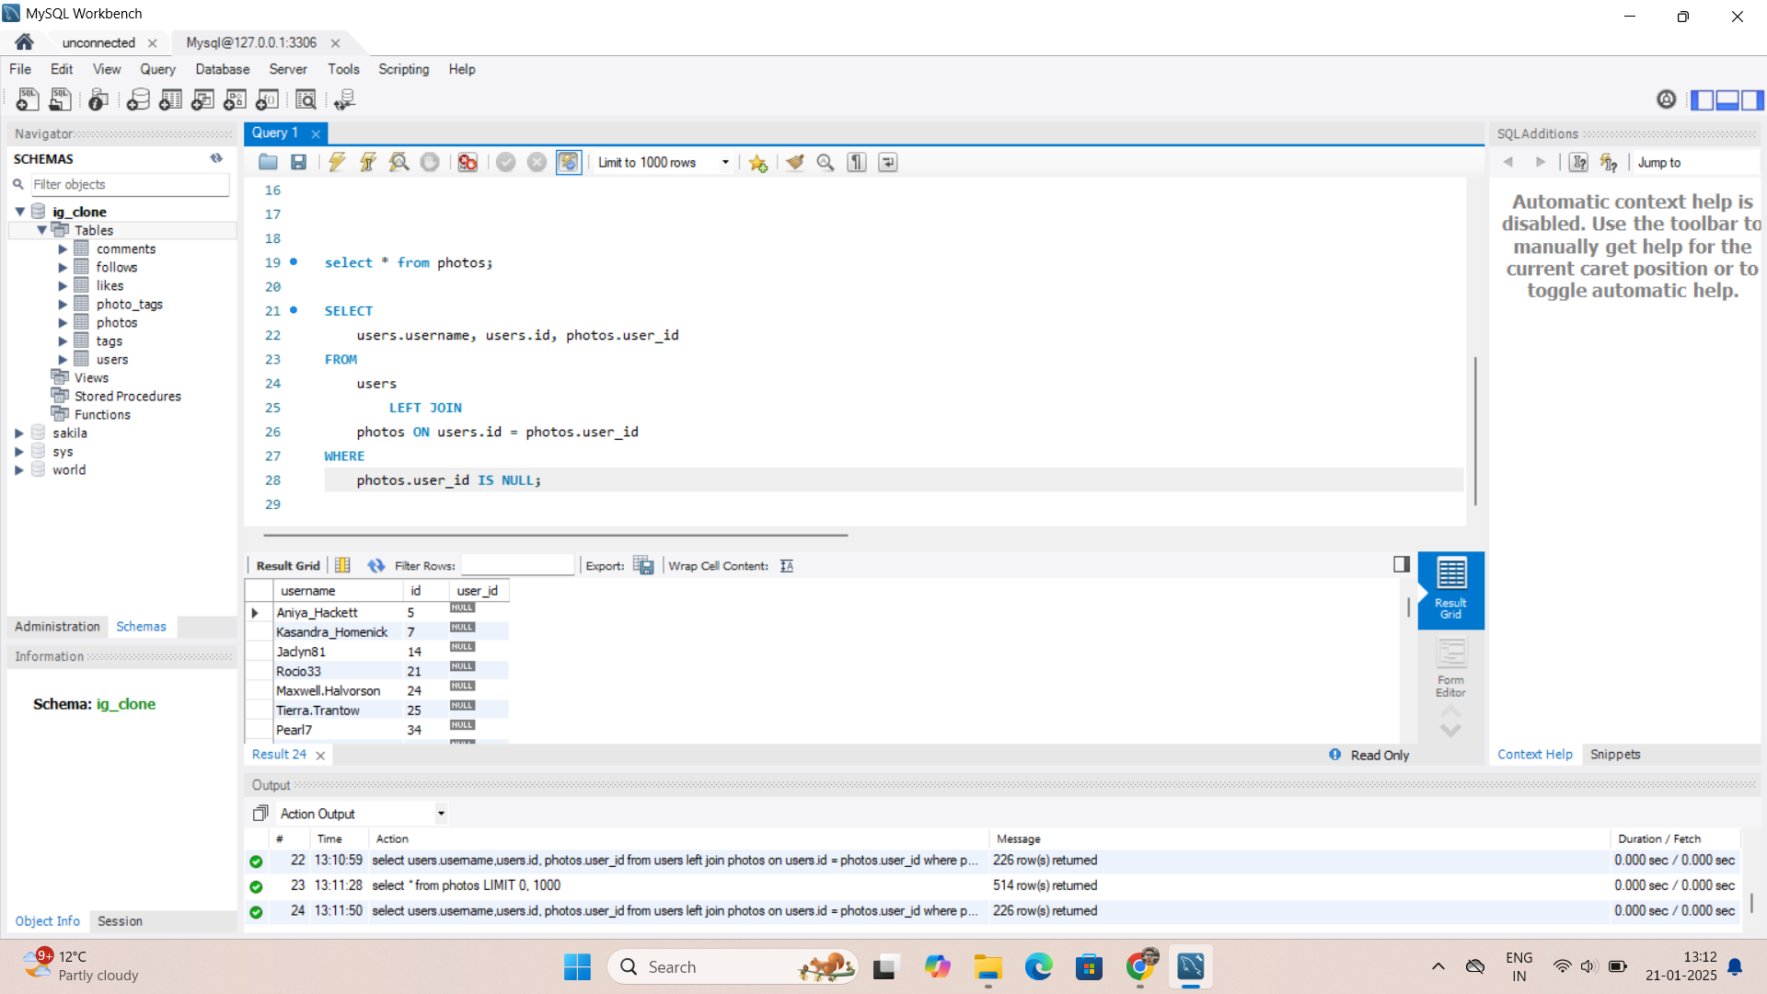
Inactive User Engagement- Identifying the inactive users to encourage them to post.
Syntax- SELECT Column1, Column2, Column3
FROM Table1
LEFT JOIN Table2 ON Column2=Column3
WHERE Column3 IS NULL;
Description- We have selected username and user
id from Users table and user id from Photos table,
Then we have joined the two tables using left
join on user id columns and printed results where
user id is null in Photos table, indicating users who
have not posted any post.
Result- We have got all the usernames who have
not posted any post along with their user ids.

Slide 5
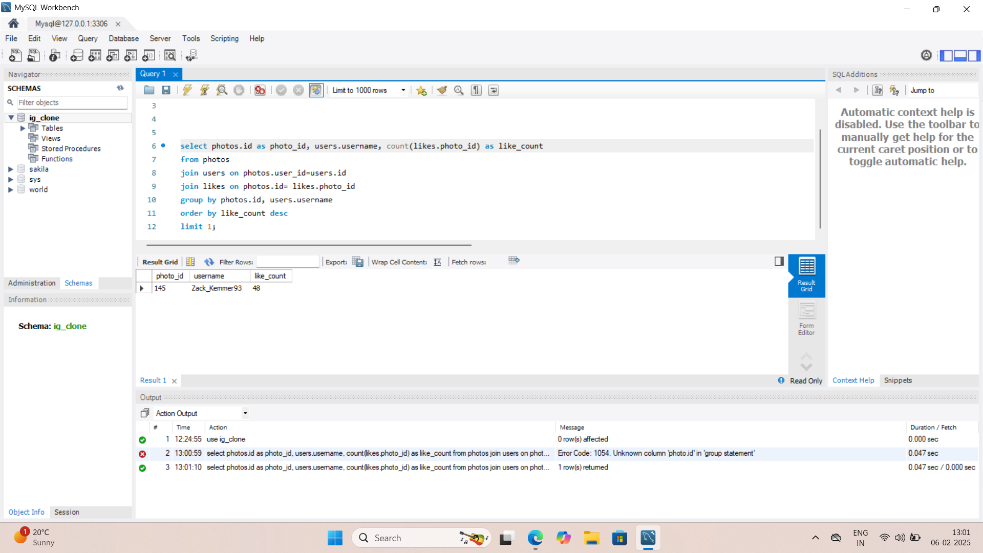
Contest Winner Declaration- Identifying the user who has got maximum likes on a single post for a competition.
Syntax- SELECT Column1 as C1, Column2,
COUNT(Column3) as C3 FROM Table1
JOIN Table2 ON Column4=Column5
JOIN Table3 ON Column1=Column3
GROUP BY Column1, Column2
ORDER BY C3 DESC LIMIT 1;
Description- We have selected Photo ID and
username from Photos and Users tables
respectively and counted total number of likes on
every post using COUNT. Then joined Users and Likes
tables and then grouped by photo id and
usernames. Then kept in descending order by likes
count and limited it to 1 to get top result with
maximum likes.
Result- We got the username who got maximum
likes on a single post along with the respective photo
id and total number of likes on that post.

Slide 6
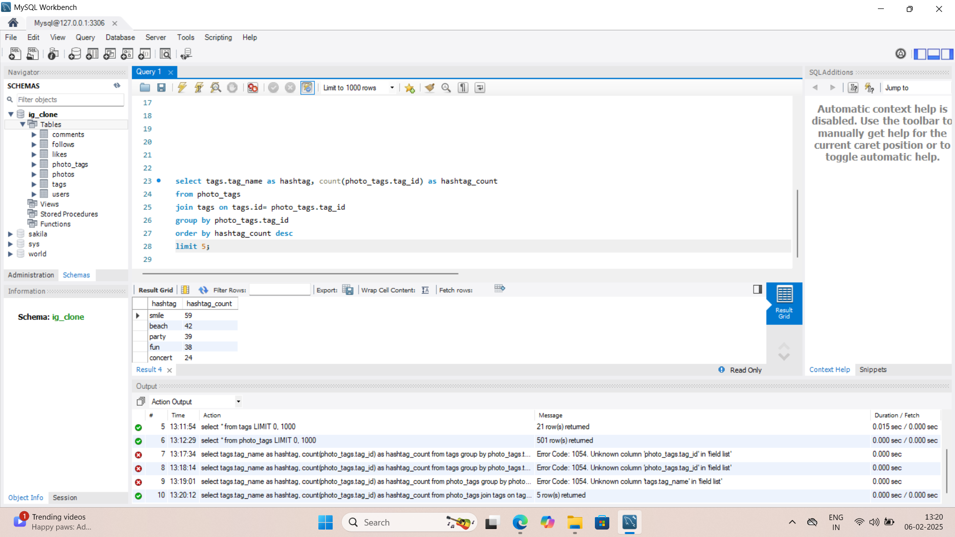
Hashtag Research- Identifying top 5 most used hashtags for marketing purpose.
Syntax- SELECT Column1 as C1,
COUNT(Column2) as C2 FROM Table1
JOIN Table2 on Column3=Column2
GROUP BY Column2
ORDER BY C2 DESC LIMIT 5;
Description- We have selected tags name and
counted the total number of times every tag is
used. Then joined the photo_tags and tags tables
and grouped it by tag ids then ordered it in
descending order by total count of each hashtag
and limit it by 5 to get top 5 most used hashtags.
Result- We have got top 5 most used hashtags
along with the number of times those are used.

Slide 7
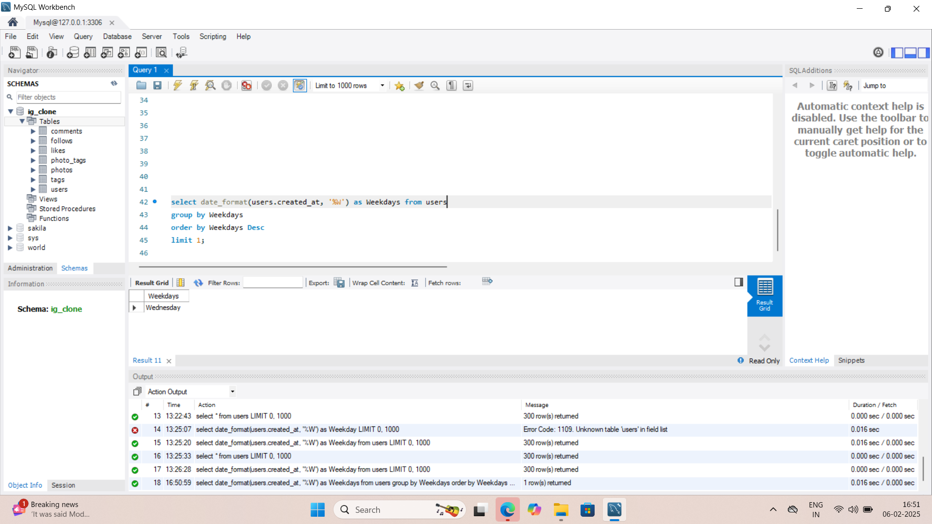
Ad Campaign Launch- Determining the day of the week on which most users register.
Syntax- SELECT DATE_FORMAT(Column1, ‘%W’) as C1
FROM Table1
GROUP BY C1
ORDER BY C1 DESC LIMIT 1;
Description- We have selected the creation date
column from users table and changed it to week
day format using ‘%W’. Then grouped and order it
by that week day and limited it by 1 to get the day
on which maximum ids are created.
Result- We have got the day of the week on which
maximum number of ids are created.

Slide 8
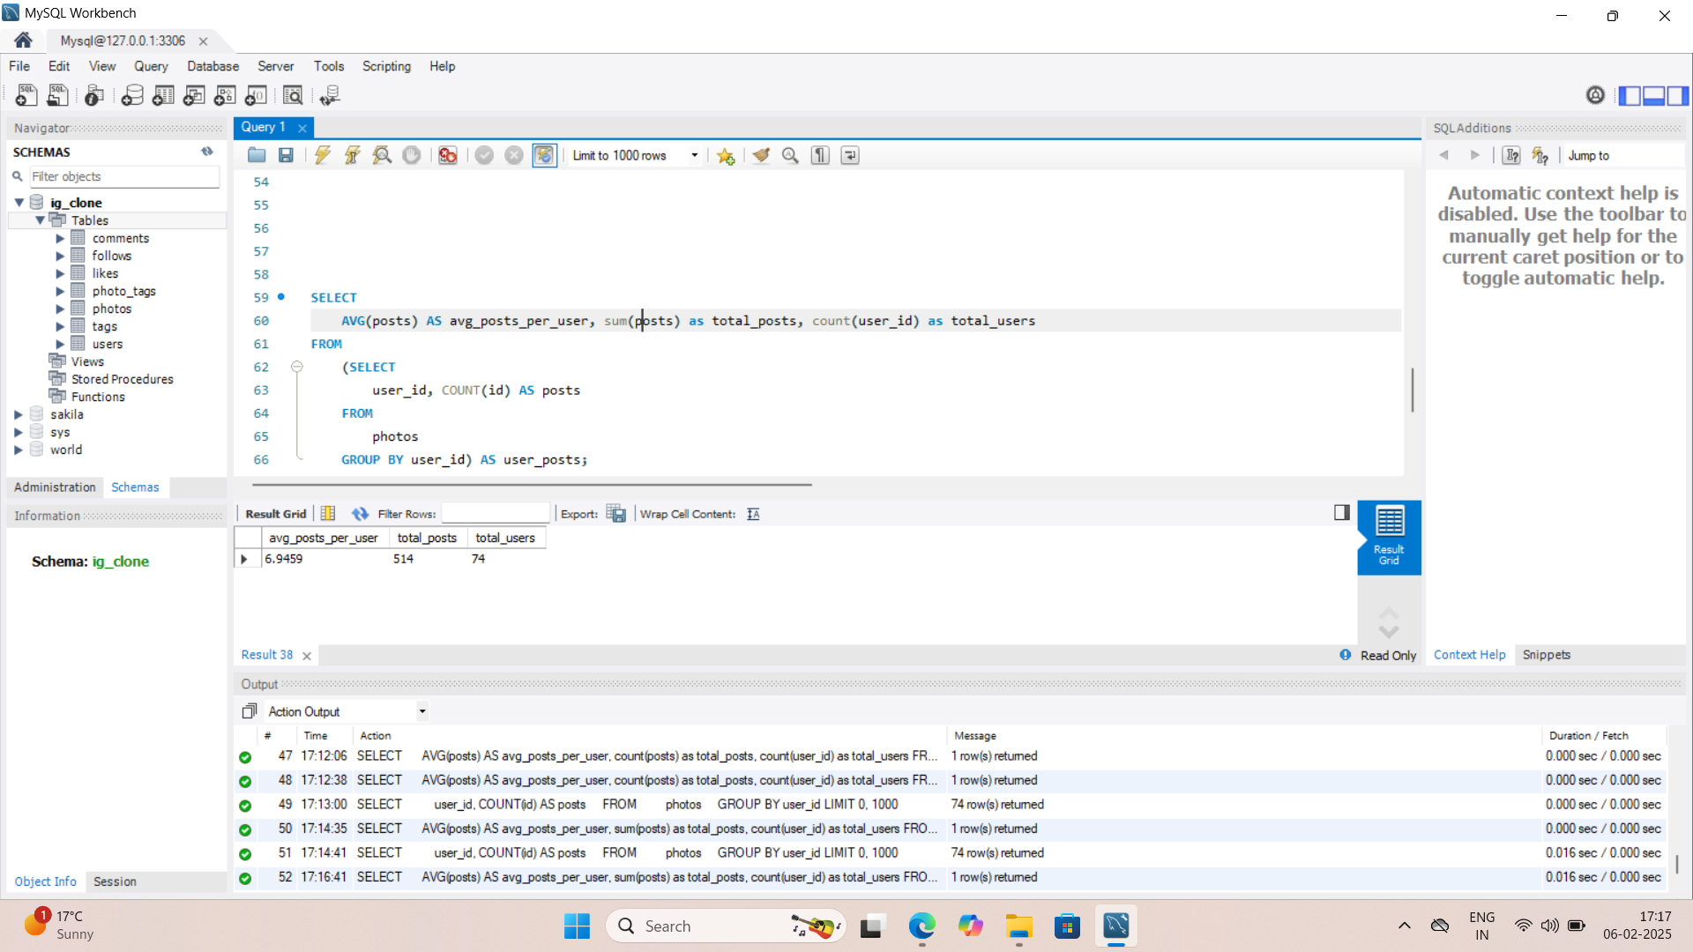
Investor Metrics- User Engagement- Calculating the average number of posts per user for user engagement.
Syntax- SELECT AVG(C2) as C2’, SUM(C2) AS C2”,
COUNT(Column1) AS C1 FROM
(SELECT Column1, COUNT(Column2) AS C2
FROM Table1
GROUP BY Column1) AS T1;
Description- We have created 1 inner query inside
an outer query. In inner query, firstly we selected
user id and counted number of photo ids from
photos table and grouped it by user id to get total
number of posts per user.
then in outer query, we have used that total posts
per user and calculated average of posts per user,
total number of posts of all users and number of
user ids that have posted posts.
Result- We have got the average number of posts per
user, total posts of all users and total numbers of users
that have posted any post.

Slide 9
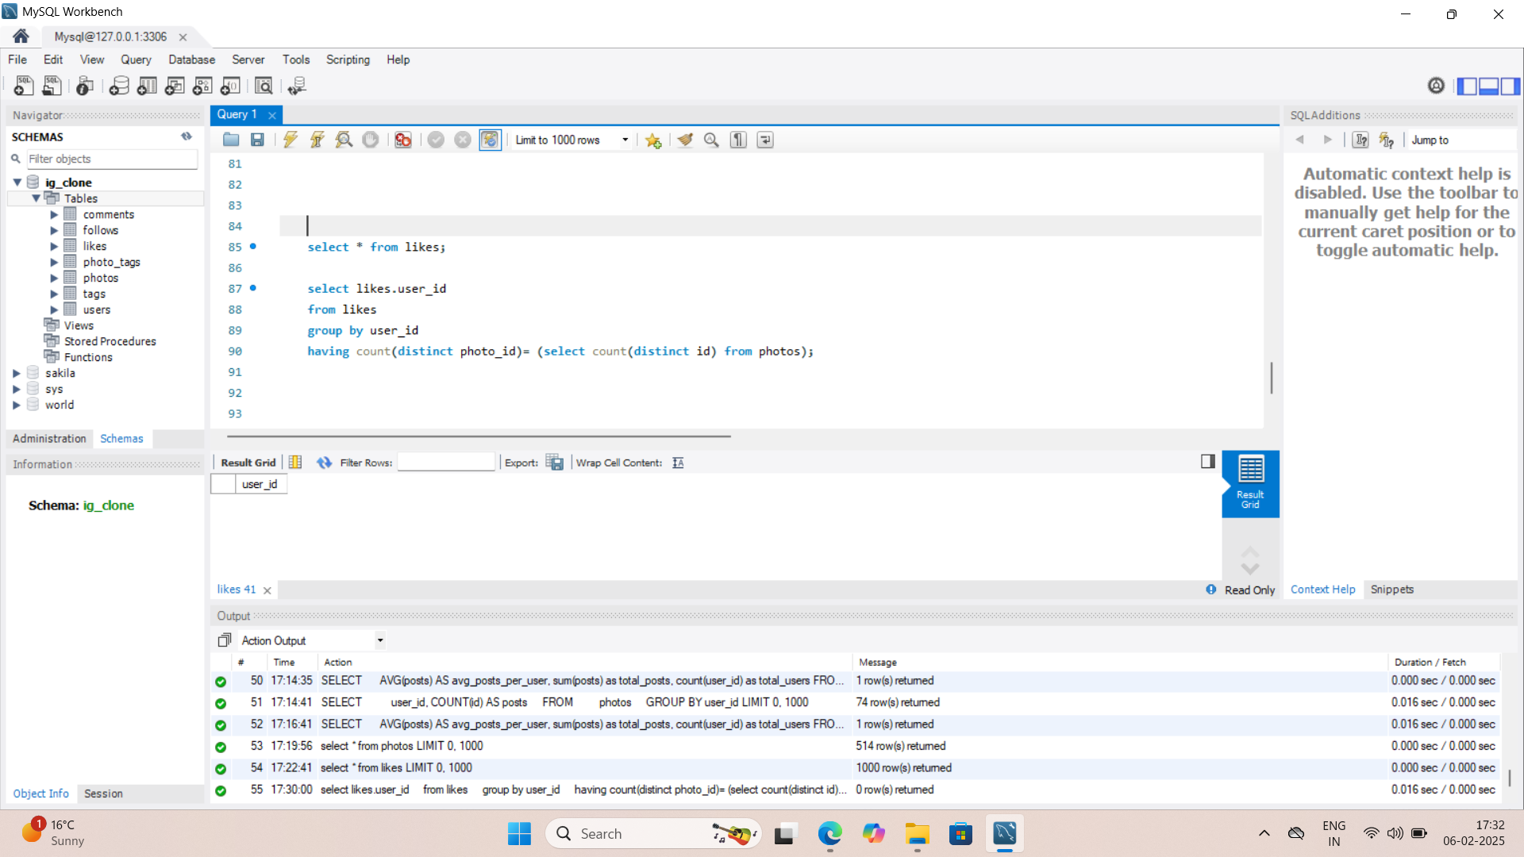
Bots and Fake Accounts- Determining fake and dummy accounts.
Syntax- SELECT Column1
FROM Table1
GROUP BY Column1
HAVING COUNT (DISTINCT Column2)=
(SELECT COUNT(DISTINCT Column3)
FROM Table2);
Description- We have selected user ids from likes
table and grouped it by itself with having total count
of distinct photo ids from likes table equal to total
count of distinct photo ids from phots table,
suggesting all the user ids which have liked all the
photo ids.
Result- We have got all the user ids which have liked
all the photo ids. The output is blank which suggests
that there is no such user id, hence there is no fake or dummy account.

Slide 10
Insights- We have analyzed and filtered the given data from given
Database to find out the desired information such as maximum likes
On a post, oldest users, inactive users, most used hashtags, most
Active weekday, avg number of posts by a user and fake accounts
Using MySQL. In this project we learned to right queries and
manipulate and filter data.
Result- The desired results are mentioned with each description
Respectively and at the end of this project, as a result we learned
To write queries and manipulate data using MySQL.

